Slide 1
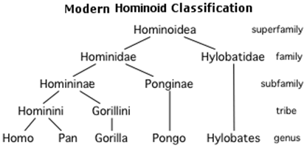
Trees
A data structure for hierarchical data
data stored in nodes (or vertices)
Every node except the root has exactly one parent
root
depth = 0
siblings
child 1
child 2
height
= 3
internal
node
leaf 1
leaf 2
depth = 2
Vocabulary
Root node
Leaf node
Edge
Child/parent
Siblings
Internal node
Ancestor/descendent
Depth of a node
Height of a tree
non-linear!
leaf 3
parent 1
parent 2
illegal
child

Slide 2
Binary Trees
A binary tree is a tree where each internal node has at most two children
sometimes indicated as left-child and right-child
Implementation:
typedef struct node {
int data; /* or some other type */
struct node *left;
struct node *right;
} tNode;
If an internal node only has one child, left or right will be NULL
for a leaf, left = right = NULL
To access: tNode *root; /* NULL, if tree is empty */

Slide 3
Creating a node
Suppose we want to create a new node containing some data D
the left child should be the sub-tree L
the right child should be the sub-tree R
L and R could be empty
tNode *makeNode(int D, tNode *L, tNode *R) {
tNode *node = (tNode *) malloc(sizeof(tNode));
if(node == NULL) { return NULL; }
node->data = D;
node->left = L;
node->right = R;
return node;
}
D
L
R

Slide 4
Question
What kind of a tree does the following code make?
tNode *makeNode(int D, tNode *L, tNode *R) {
/* code from previous slide */
}
void main() {
tNode *n1, *n2, *n3, *n4, *root;
n1 = makeNode(1, NULL, NULL);
n2 = makeNode(2, n1, NULL);
n3 = makeNode(3, NULL, NULL);
n4 = makeNode(4, n3, n2);
root = makeNode(0, NULL, n4);
}
0
4
3
2
1

Slide 5
Simplified forall function for trees
Suppose we want to print all nodes in a tree:
void forall(tNode *node) {
if(node == NULL) { return; }
printf("%d\n", node->data);
forall(node->left);
forall(node->right);
}
Question 1: What happens on this?
Question 2: How about with this change?
first version: preorder traversal (this, left, right)
second version: inorder traversal (left, this, right)
also: postorder traversal (left, right, this)
0
4
3
2
1

